Slide 1
DIGITAL PORTFOLIO
STUDENT NAME: EVANGELINA B
REGISTER NO AND NMID: asunm1397222406211
DEPARTMENT: BSC
COLLEGE: SRM ARTS AND SCIENCE COLLEGE MADRAS UNIVERSITY

Slide 2
PROJECT TITLE Concept to Creation

Slide 3


AGENDA
Problem Statement
Project Overview
End Users
Tools and Technologies
Portfolio design and Layout
Features and Functionality
Results and Screenshots
Conclusion
Github Link
3/21/2024 Annual Review

Slide 4

PROBLEM STATEMENT
In today's digital-first world, individuals often struggle to present their skills, achievements, and work experience in a centralized, accessible, and visually appealing format. Traditional resumes and paper-based portfolios are limited in scope, lack interactivity, and do not effectively showcase dynamic or multimedia content.
There is a need for a digital solution that allows users to create and manage personalized portfolios that highlight their professional and creative capabilities.

Slide 5

PROJECT OVERVIEW
A Digital Portfolio is an online platform that enables individuals to effectively present their skills, achievements, experiences, and creative work in a structured and visually engaging format. This project focuses on designing and developing a responsive and customizable web-based digital portfolio that can serve students, professionals, and creatives alike.
The portfolio will allow users to organize their content into different sections such as about Me, Resume/CV, Projects, Skills, Certificates, Gallery, and Contact Information. It will also support the integration of multimedia elements such as images, videos, PDFs, and external links to demonstrate competencies and showcase work.

Slide 6

WHO ARE THE END USERS? For most personal portfolios, the creator is the sole back-end user, handling all of these tasks. For more robust or team-based projects, these specialized roles ensure the portfolio remains functional, secure, and well-managed over time Content managers or editors Administrators Technical support Data analysts

Slide 7

TOOLS AND TECHNIQUES
HTML :The standard markup language for creating the structure of your website, including headings, paragraphs, and sections for projects, skills, and contact information.
CSS : Used to control the appearance and layout of your HTML elements, including colors, fonts, spacing, and animations.
JavaScript : A programming language that adds interactivity and dynamic functionality to your website, such as image sliders, form validation, or smooth scrolling effects.
Visual Studio Code : A lightweight yet powerful and highly customizable open-source editor with a vast library of extensions.

Slide 8
PORTFOLIO DESIGN AND LAYOUT
About
Skills
Education
Resume
8

Slide 9
FEATURES AND FUNCTIONALITY
Homepage/Landing Page: Introduces a professional role and value proposition.
About Me Section: A personal narrative detailing background, career goals, skills, and motivations. Include a professional photo to connect with the audience.
Projects/Work Samples Section: Showcases the best work. Each project should include a title, brief description, and the role performed.
Resume/CV: A downloadable PDF of the resume for recruiters.

Slide 10
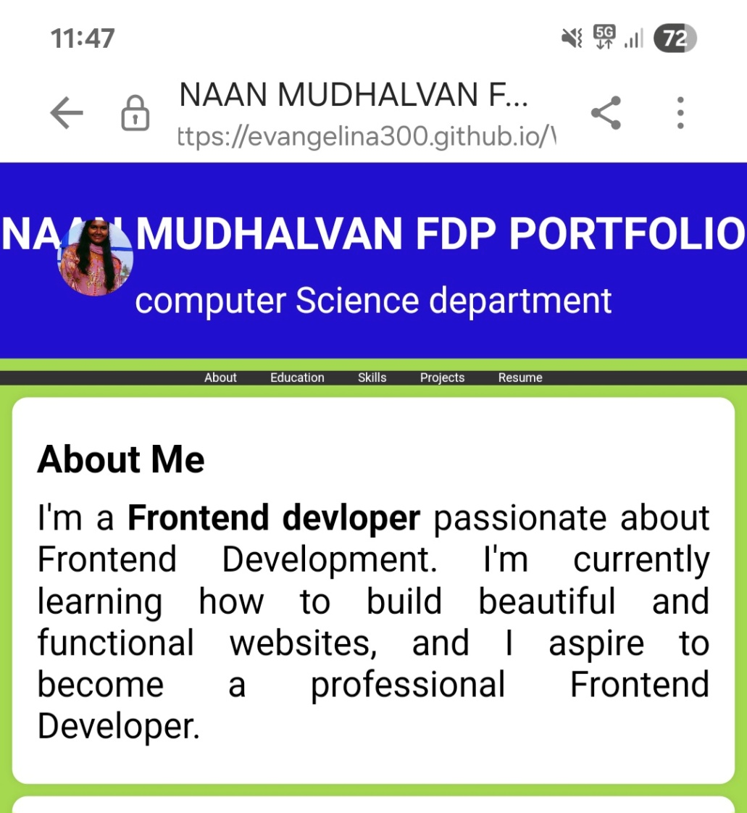

RESULTS AND SCREENSHOTS
3/21/2024 Annual Review
10

Slide 11
CONCLUSION
This digital portfolio represents the culmination of my journey through front end web development, demonstrating my growth as a student. The process of building this site with HTML, CSS, and JavaScript was a valuable exercise in not only technical development but also in critical self-reflection.
11

